Slide 1
Are you ready to help change the
CryptoSphere forever?
PD V1 7.1.22 last updated
"Making Blockchain Safer Everyday" ™

Slide 2
HUMAN ERROR happens daily in millions of cryptocurrency transactions
Digital assets are forever lost
1/5
of all BTC is LOST
1500
BTC are lost each day
20%
of BTC has been misplaced
Click here to view link
Click here to view link
Click here to view link

Slide 3
All level of Cryptocurrency users experience some level of FEAR when making transactions
Customers lose their assets when Centralized Exchange Owner
dies without leaving the password
Click here to view link
More than two thirds of people interviewed for Blockchain Usability Report have some sort of fear when making cryptocurrency transactions
Cryptocurrency users can
LOSE EVERYTHING even when
they may not be at fault
Click here to view link

Slide 4
SENDING cryptocurrency to the WRONG WALLET address
is the most common mishap among transactional errors.
$20M
Optimism Foundation in 2022 sends OP to the wrong wallet
$36M
Typo Moves Seized JUNO Tokens
to Wrong Wallet
$90M
DeFi bug accidentally sends out millions to its own users
Click here to view link
Click here to view link
Click here to view link

Slide 5
ALL cryptocurrency users at one point in time have the potential to
LOSE THEIR PASSWORDS OR KEYS
$250M
Man Who Forgot Bitcoin Password Makes 'Peace' with $250 Million Loss:
'Time Heals All Wounds'
$140B
Billions worth of Bitcoin have been locked by people who forgot their key
$545M
Investors likely to lose almost $545 million worth Bitcoin in 2022 by forgetting passwords and various other mistakes, suggests report
6000
Bitcoin lost when personal belongings were thrown away by landlord
Click here to view link
Click here to view link
Click here to view link
Click here to view link
Time & time Again

Slide 6
CRYPTOCURRENCY PROBLEMS
01
Human error even if mistakenly
02
Everyone always sends test transactions prior to submitting their real transaction leading to additional fees and time to avoid FEAR of losing the money involved with the transaction
03
Transactions being sent to the WRONG WALLET ADDRESS
What are current problems EVERY blockchain is faced with,
EVERY level of user in cryptocurrency is faced with,
AND the whole Market Cap is faced with?
04
Everyone has a fear of losing one’s private keys and access to their wallet
05
The normal fear and stress at all levels of crypto users when sending transaction
06
Transactions being sent to the wrong token / coin type:
BEP2 vs BEP20 VS ERC20 VS ERC721

Slide 7
Problem #2 SIDE NOTE
https://www.consultancy.uk/news/25975/global-market-size-of-digital-payments-industry-soares
What if the $42,00,000,000 ANNUALLY went back to the USERS?
As more people adopt using Crypto there will be an increase in the number of transactions taking place
More transactions = More fees
MODUS
resolves this problem immediately which then in turn results in less transactions taking place across the whole global market, less fees being charged, and more money to the user.
Total number of transactions for | 2020 | 700,000,000,000
Avg transaction fee |  |  |  | Estimated Fees
test ($25) | BNB | $ 0.06 |  | $ 42,000,000,000
 | BNB | $ 1.14 |  | $ 798,000,000,000
 | BTC | $ 23.86 |  | $ 16,702,000,000,000
 | ETH | $ 24.67 |  | $ 17,269,000,000,000
 | AVG | $ 12.45 |  | $ 8,715,000,000,000

Slide 8
SOLUTION
© OMNIMODUS, LLC 2022
8

Slide 9
WHAT ARE the USE CASES?
1. Store of Value
Retains future purchasing power
Readily exchangeable for something else
© OMNIMODUS, LLC 2022
9

Slide 10
2. Transactional Types
Private
Zero Proof Technology
Public
Receipt
Full decentralized as Blockchain was intended
Blockchain hash recording
Natural transaction IE off chain
Omnimodus Dusnet Platform IE on chain

Slide 11
3. Blockchain Choice
SPEED
SECURITY
SCALABILITY
One of the fastest in the market @ est
Million+ TPS
Definitive security features
including 3FA
Cross chain ever evolving abilities with the potential of Horizontal Sharding
Will be one of the most reliable, safest, Decentralized, & Renounced
© OMNIMODUS, LLC 2022
11

Slide 12
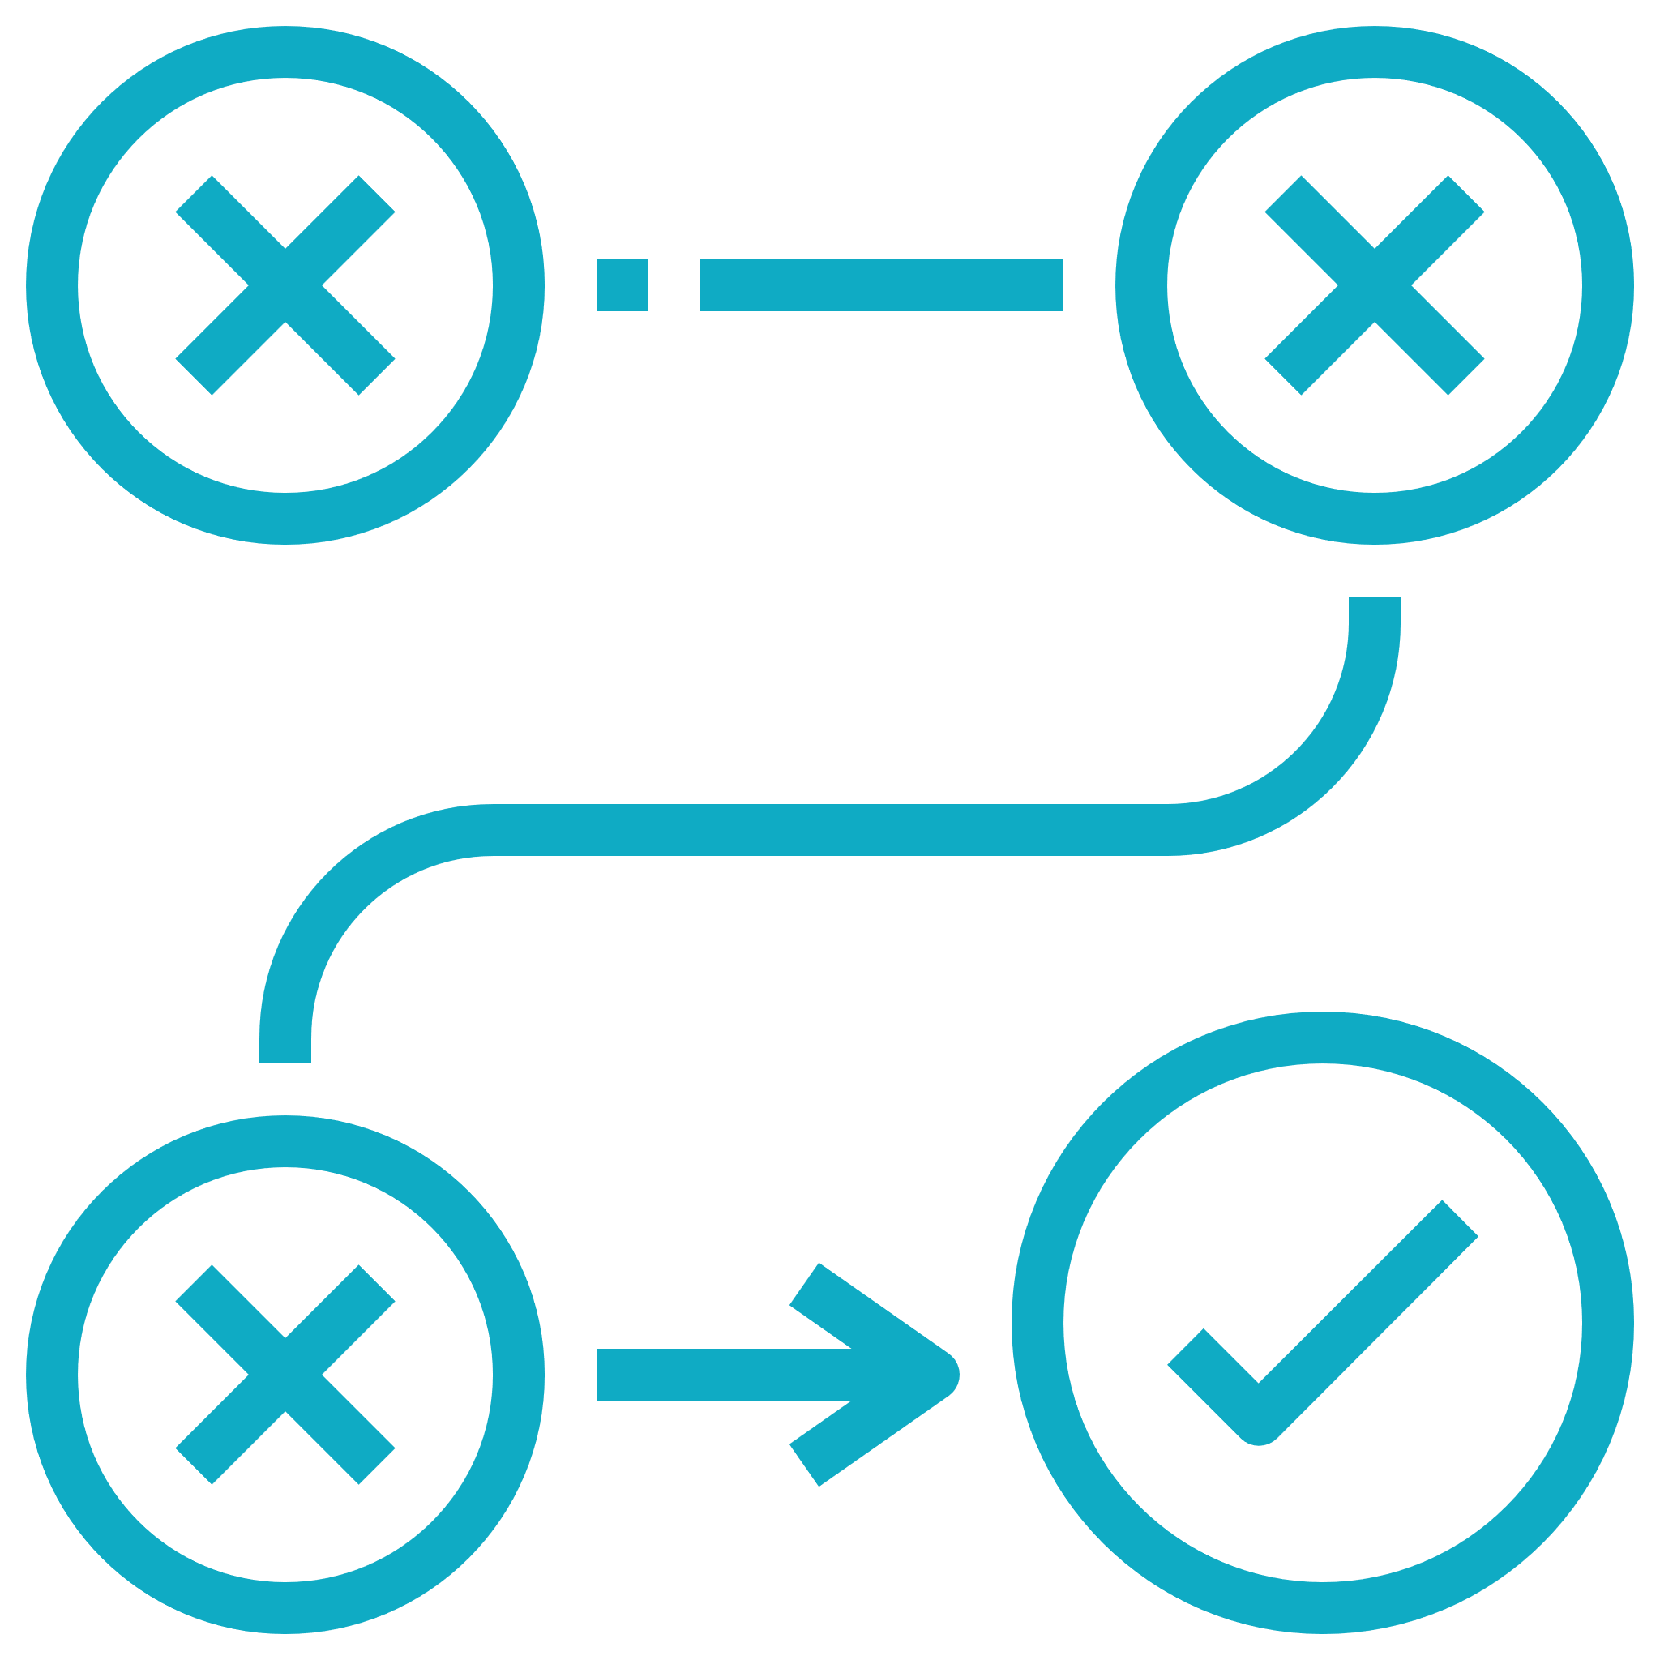
4. Human Error is removed
Timer
The Receiver of MODUS will have a certain amount of time to enter a password for transaction or it will be sent back to Sender automatically
Tries
The Receiver of MODUS will have a certain number of tries to enter a password for transaction or it will be sent back to Sender automatically
Password The Receiver of MODUS will immediately receive a password via text or email from the Sender to proceed with the transaction
Undo
Sender will have 2 options prior to sending the transaction:
Cancel or Bypass

Slide 13
5. Emotion & Fear are removed when making a transaction
Scared to make transactions but NOW knowing either the Receiver will claim it or it is returned to the Sender
Those who already have lost due to a variety of transactional errors NOW gain a sense of relief when sending a transaction
Risk vs Reward in every transaction NOW have mitigated most of the potential risks when submitting a transaction
Accidents vs Mistakes will always happen but NOW have the ability to resolve any that may occur when performing a transaction

Slide 14
6. Benefactor Service
Enter up to any # of wallet address
Enter in a date & time
Should you not ever gain control of your wallet,
lose your the password,
or lose your seed phrase
THEN
Your Wallet will send any remaining MODUS to those
Wallet Addresses on those Dates as the User has previously specified

Slide 15
7. COIN USE CASE VERSE COMPANY / PLATFORM USE CASE
Needs to survive----→
OMNIMODUS
DUSNET
←---- Does not need to survive
MODUS
MODUS does not need Omnimodus or DUSNET to exist OR BE TRADEABLE ON EXCHANGES
but
OMNIMODUS require MODUS for the DUSNET platform to work and exist,
go about business, & CARRYON THE MISSION AND Vision of the Company

Slide 16
8. Services
Company is Not an escrow service
or money services broker
Doesn’t require Company
internal servers
For MODUS to be executable
Funds are never held in Company hands
Funds are never held in Company hands
MODUS will never generate any revenues or have an expectation of profits BUT Omnimodus will have many streams of income generation that will evolve over time & potentially consist of but inclusive of:
Selling MODUS coins
Transactional fees on the platform
Advertising
Sponsorships
Investment purchases of other new Blockchains or Nodes
Whitelabel Metal debit cards
Cold Storage wallets
Ugandan Coffee milling / distribution
Production Company for crypto related hallmark movies
Among other potential ideas, projects, entities to be determined

Slide 17
MODUS Legalities
01
Passes the US Supreme Court, SEC V W.J. Howey CO under the Howey Test as stated in: SEC v. W.J. Howey Co., 328 U.S. 293 (1946)
This coin could potentially be one of the most traded currencies with one of the most valid uses among the crypto atmosphere that could ease the fears of those US regulators who oppose crypto but It is the belief of OMNIMODUS, INC that the creation of MODUS:
02
Follows the Digital Asset framework as stated in: Statement on “Framework for ‘Investment Contract’ Analysis of Digital Assets”
03
Will abide by Lummis-Gillibrand Responsible Financial Innovation Act

Slide 18
TIMELINE
Phase 1
Phase 2
Phase 3
Phase 4
COIN
DUSNET
SCALABILITY
BENFACTOR
On/Off blockchain transactions
Speed, Security, Scalability
Doesn’t need a platform to work
40 business days upon adequate funding * Does not include any time for multiple audits from third parties
Internal Platform to send on chain transactions
* this will be ever evolving
40 business days after Phase 1 completion
Internal SWAP * this will be ever evolving
Remove the means of bridging
40 business days after Phase 2 completion
Never lose your wallet assets
Automatic Wallet Redemption
40 business days after Phase 3 completion

Slide 19
MODUS Tokenomics
Omnimodus LLC |  | Ticker: MODUS
Total Initial Supply |  | 338,000,000
Creator/s | 5% | 16,900,000 | Blacklist 3 years, time locked 14.2% release per year for 7 years
Creator/s gifted to OMNIMODUS, INC | 95% | 321,100,000
 | 100%
OMNIMODUS INC
IEO/VC/PI/Equity Share | 20% | 64,220,000 | Blacklist 3 years, time locked 14.2% release per year for 7 years
Circulating Supply upon open | 30% | 96,330,000
Releasable Supply next 10 years | 50% | 160,550,000
 | 100% | 321,100,000 | Total potential circulating supply
160,550,000 | 10 | 16,055,000 | coins released every year for 10 years
16,055,000 | 12 | 1,337,917 | coins automatically released every month

Slide 20
"Making Blockchain Safer Everyday" ™
Links
SOCIAL LinkedIn
COMPANY Website
OTHER Links:
TG Announcement Channel: https://t.me/omnimodusllc
MEDIUM: https://medium.com/@omnimodusllc
TWITTER: @Omnimodusllc
GITHUB: https://github.com/OmnimodusLLC/MODUS
DUNS #: 118721214
verification: https://www.dnb.com/ type # or name in search bar
*sites and links maybe active but may show little to no activity until funding is received.
WHITEPAPER V1 Will be available upon 7.20.22
Mail to: george@omds.io
For any remaining questions or concerns please send an email

